Slide 1
Second Year B. Tech. Advanced Data Structures (CS228)
By
Dr. Pramod D. Ganjewar
Senior Assistant Professor,
School of Computer Engineering,
MIT Academy of Engineering, Alandi(D.),Pune

Slide 2
Unit – 1 Trees Binary Search Tree (BST) and its Operations

Slide 3
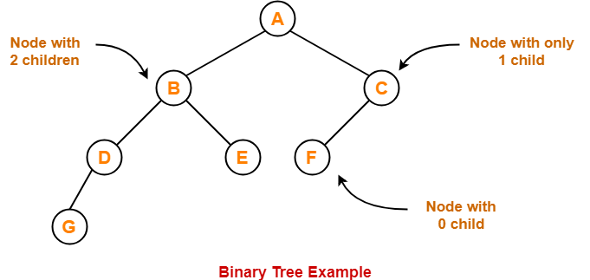
Binary Tree
Binary Tree
Binary tree is a special tree data structure in which each node can have at most 2 children.
Thus, in a binary tree, Each node has either 0 child or 1 child or 2 children.

Slide 4
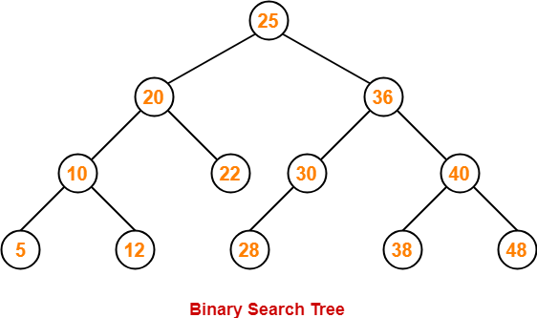
Binary Search Tree
Binary Search Tree
Binary Search Tree is a special kind of binary tree in which nodes are arranged in a specific order.
In a binary search tree (BST), each node contains-
Only smaller values in its left sub tree
Only larger values in its right sub tree

Slide 5
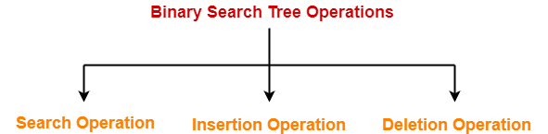
Binary Search Tree Operations
Binary Search Tree Operations-
Commonly performed operations on binary search tree are-
Search Operation
Insertion Operation
Deletion Operation

Slide 6
BST – Search Operation
Search Operation
Search Operation is performed to search a particular element in the Binary Search Tree.
Rules-
For searching a given key in the BST,
Compare the key with the value of root node.
If the key is present at the root node, then return the root node.
If the key is greater than the root node value, then recur for the root node’s right subtree.
If the key is smaller than the root node value, then recur for the root node’s left subtree.

Slide 7
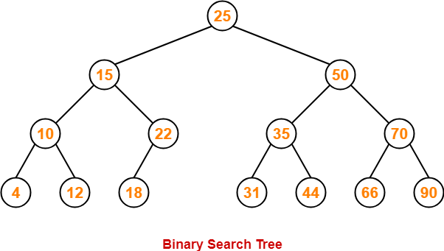
BST – Search Operation
Example-
Consider key = 45 has to be searched in the given BST-
We start our search from the root node 25.
As 45 > 25, so we search in 25’s right subtree.
As 45 < 50, so we search in 50’s left subtree.
As 45 > 35, so we search in 35’s right subtree.
As 45 > 44, so we search in 44’s right subtree but 44 has no subtrees.
So, we conclude that 45 is not present in the above BST.

Slide 8
BST – Insert Operation
Insert Operation
Insertion Operation is performed to insert an element in the Binary Search Tree.
Rules-
The insertion of a new key always takes place as the child of some leaf node.
For finding out the suitable leaf node,
Search the key to be inserted from the root node till some leaf node is reached.
Once a leaf node is reached, insert the key as child of that leaf node.

Slide 9
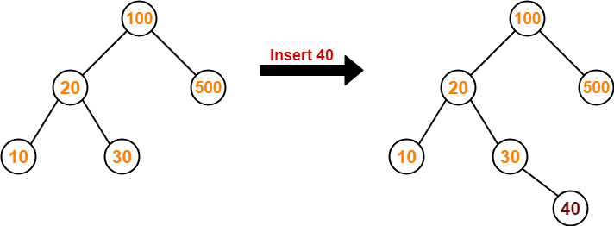
BST – Insert Operation
Example-
Consider the following example where key = 40 is inserted in the given BST
We start searching for value 40 from the root node 100.
As 40 < 100, so we search in 100’s left subtree.
As 40 > 20, so we search in 20’s right subtree.
As 40 > 30, so we add 40 to 30’s right subtree.

Slide 10
BST – Delete Operation
Delete Operation
Deletion Operation is performed to delete a particular element from the Binary Search Tree.
When it comes to deleting a node from the binary search tree, following three cases are possible-
Case-01: Deletion Of A Node Having No Child (Leaf Node)
Case-02: Deletion Of A Node Having Only One Child
Case-03: Deletion Of A Node Having Two Children

Slide 11
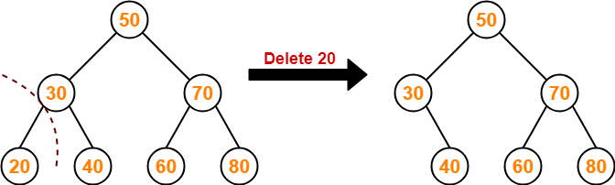
BST – Delete Operation
Case-01: Deletion Of A Node Having No Child (Leaf Node)
Just remove / disconnect the leaf node that is to deleted from the tree.
Example-
Consider the following example where node with value = 20 is deleted from the BST-

Slide 12
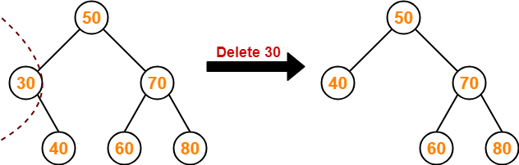
BST – Delete Operation
Case-02: Deletion Of A Node Having Only One Child-
Just make the child of the deleting node, the child of its grandparent.
Example-
Consider the following example where node with value = 30 is deleted from the BST-

Slide 13
BST – Delete Operation
Case-03: Deletion Of A Node Having Two Children-
A node with two children may be deleted from the BST in the following two ways-
Method - 01:
Visit to the right subtree of the deleting node.
Pluck the least value element called as in-order successor.
Replace the deleting element with its in-order successor.

Slide 14
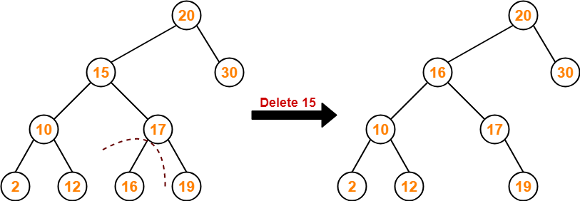
BST – Delete Operation
Case-03: Deletion Of A Node Having Two Children (Method-01)
Example-
Consider the following example where node with value = 15 is deleted from the BST-

Slide 15
BST – Delete Operation
Case-03: Deletion Of A Node Having Two Children-
A node with two children may be deleted from the BST in the following two ways-
Method – 02 :
Visit to the left subtree of the deleting node.
Pluck the greatest value element called as in-order predecessor.
Replace the deleting element with its in-order predecessor.

Slide 16
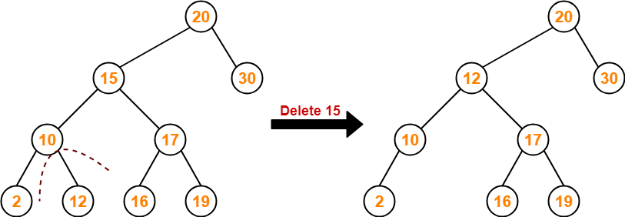
BST – Delete Operation
Case-03: Deletion Of A Node Having Two Children (Method - 02)
Example-
Consider the following example where node with value = 15 is deleted from the BST-

Slide 17
BST – Delete Operation
Case-03: Deletion Of A Node Having Two Children
Example-
Deletion of Node having Two Children so consider Node – 65.

Slide 18
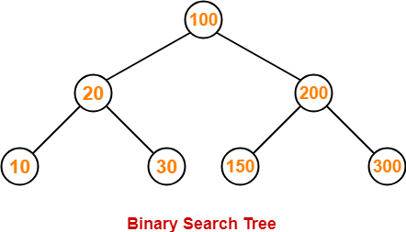
BST Traversal
A binary search tree is traversed in exactly the same way a binary tree is traversed.
In other words, BST traversal is same as binary tree traversal.
Example-
Consider the following binary search tree-

Slide 19
BST Traversal
Example- Consider the following binary search tree-
Now, let us write the traversal sequences for this binary search tree-
Preorder Traversal - 100 , 20 , 10 , 30 , 200 , 150 , 300
Inorder Traversal - 10 , 20 , 30 , 100 , 150 , 200 , 300
Postorder Traversal - 10 , 30 , 20 , 150 , 300 , 200 , 100

Slide 20
BST Traversal
Note - 01
In-order traversal of a binary search tree always yields all the nodes in increasing order.
Note - 02
Unlike Binary Trees,
A binary search tree can be constructed using only pre-order or only post-order traversal result.
This is because in-order traversal can be obtained by sorting the given result in increasing order.

Slide 21
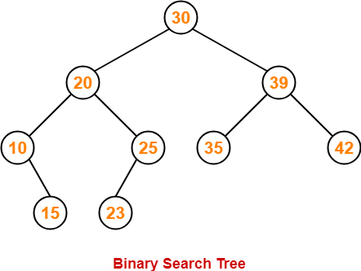
BST Traversal - Exercise
Example
Write Pre-order, In-order and Post-Order traversal for the given tree.
Pre – order Traversal :- ?
In-order Traversal :- ?
Post-order Traversal : 15 , 10 , 23 , 25, 20, 35, 42, 39, 30

Slide 22
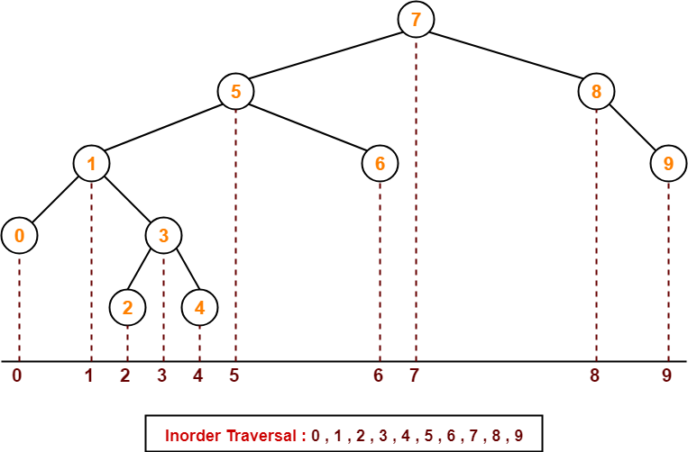
BST Traversal - Exercise
Example
Write Pre-order, In-order and Post-Order traversal for the given tree.
Pre – order Traversal :- ?
In-order Traversal :- 0,1,2,3,44,56,7,8,9
Post-order Traversal : ?

Slide 23
Thank You

